Slide 1

Project (AI101B) Even Semester Session 2024-25
Multimodal Sentiment Analysis (Text + Image)
Presented By
Shadab Idrishi
Rahul Pratap Singh Chauhan
Shalini Mishra
Project Supervisor:
Apoorv Jain

Slide 2

Multimodal Sentiment Analysis (Text + Image)
Multimodal Sentiment Analysis is the process of analyzing a person’s feelings or emotions using more than one type of data — like text + image.

Slide 3

What is Sentiment Analysis?
Sentiment Analysis is the process of identifying whether a piece of text expresses a positive, negative, or neutral emotion.
Example: "I love this place!" → Positive
Traditional sentiment analysis works mostly on text only.

Slide 4

What is Multimodal Sentiment Analysis?
Multimodal Sentiment Analysis is the process of analyzing emotions using both text and images together for more accurate sentiment detection.
We combine image and text together to understand the true emotion.
Useful for analyzing social media posts, memes, product reviews, etc.

Slide 5

Why Combine Text + Image?
Because text alone can be ambiguous, and images provide context. Combining both helps in understanding the true sentiment more accurately.
Both combined give better accuracy.

Slide 6

Tools and Technologies Used
Google Colab: Cloud-based Python coding platform
Python Libraries:
Transformers for text analysis
PyTorch for models
Pillow for image processing
CLIP by OpenAI

Slide 7
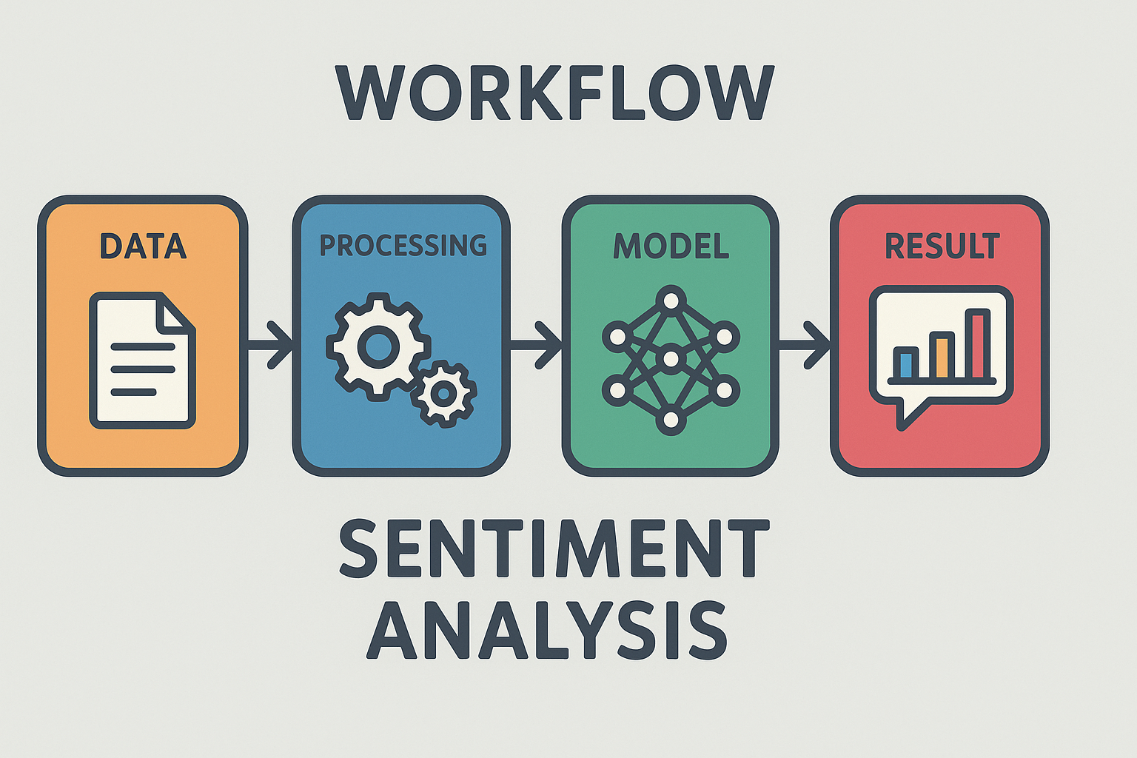
Workflow / Architecture
Input: Text + Image
Preprocessing: Clean text, resize image
Feature Extraction: Text embeddings + image embeddings
Model Fusion: Combine both features
Classification: Output sentiment label

Slide 8

Applications
Social media monitoring
Marketing & Brand feedback
News & Meme sentiment detection
Product review analysis

Slide 9

Example: Sentiment Analysis of Memes
1
Dataset
2
Model
Collection of memes combining text and images.
BERT for text, ResNet for image features, fused in one network.
3
Results
Higher accuracy and F1-score than unimodal models.

Slide 10

Conclusion: Future Directions
Multimodal analysis improves accuracy over single-mode (text/image only).
Google Colab makes implementation easier for students.
Future scope: Use videos, audio, or real-time analysis.

